Slide 1

INTRODUCING
MAXIMIZE BATTERY FLEET PERFORMANCE

Slide 2

MAXIMIZE PRODUCTIVITY
24/7 LEARNING MANAGEMENT PLATFORM
INCREASE ASSET ROI AND WARRANTY PROTECTION

Slide 3
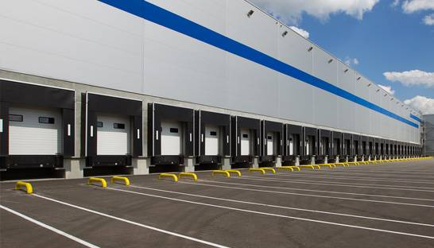

MAXIMIZING BATTERY FLEET PERFORMANCE
WHO NEEDS BATTERY MANAGER AND WHY NOW?
Large corporations have more mega distribution centers than ever before. These sites are often benchmarked against each other
These companies have more distribution centers than ever before with more employees engaged with expensive battery and charger assets
Skilled employees are hard to find and turnover is at historically high levels. The majority of workers have short attention spans and low skillsets
Training new employees is expensive and time consuming
These huge companies with multiple DC’s and hundreds of employees working in multiple distribution centers are in desperate need of a software-based management system that maximizes battery fleet performance, trains their employees, and protects their assets.

Slide 4



BATTERY MANAGER
MANAGE YOUR PEOPLE AND YOUR ASSETS
OPERATIONAL
BENEFITS
EQUIPMENT AND FACILITY BENEFITS
WARRANTY PROTECTION
Boosts fleet runtime by dispatching high performance batteries
Holds back and identifies problem batteries
Boost productivity with fewer battery changes
Enterprise-wide battery room training
24/7 learning & support system accessible
via the interactive Touch Computer
Records and schedules all battery maintenance
Battery Location for efficient PM’s
Battery run time collection
Ensures battery equalization
and records it
Tracks all battery service history
Builds accurate asset list
Truck hour meter collection

Slide 5

BENEFITS OF BATTERY MANAGER
OPERATIONAL BENEFITS
Increased lift truck run time – Deploys high performance batteries
Subpar batteries can be skipped or reserved for maintenance or scrap
Less frequent battery changes equals increased productivity Move more pallets and material
Identifies problem batteries or batteries that need to be scrapped or repaired
Ability to identify in house repairs or repairs by battery vendor
Keeps the lift trucks on the DC floor and out of the battery room

Slide 6
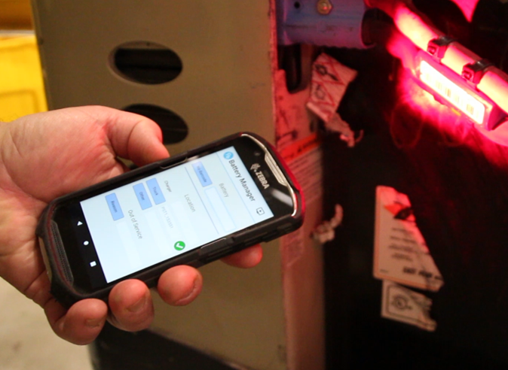

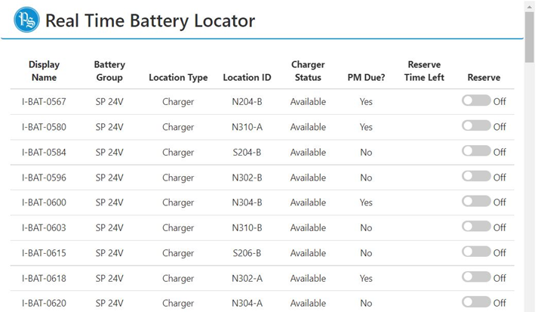
BENEFITS OF BATTERY MANAGER
EQUIPMENT AND FACILITIES
Enterprise-wide learning management platform. Every employee in every DC will receive the same exact training and continuing education
Similar to WAZE or Google Maps, Battery Manager gives users prompts instructing what to do with battery assets. If they don’t follow the prompts, it will remind them the next time they touch that asset
Interactive Touch Computer tells operators how to collect run times, when to water, wash, PM, equalize, and tracks battery location in real time
Real time live battery location details
All maintenance is scheduled by cycles or days and is tracked from cradle to grave

Slide 7
BENEFITS OF BATTERY MANAGER
WARRANTY PROTECTION
Manufacturer Warranty
Built in to the price of battery
Typically 1500 cycles
You must prove you have maintained battery
Battery must be, watered & equalized regularly
Helps protect out of pocket repair costs
Battery Manager
OEM
Battery Manager schedules and records all maintenance activities and equalize charges and can be accessed via web browser, mobile, or Touch Computer
The system builds an accurate list of all battery room assets: lift trucks, batteries, and chargers
Ensures full accountability of service and equalize records protecting your warranty
Cradle to grave life history records of your battery fleet
Hourmeter collection can be recorded in less than 5 seconds.
Battery observations and inspection reports can be easily uploaded using the touch computer
Schedules and records all service and equalize history
Keeps track of all service records
Ability to reserve batteries for service
Keeps track of all assets
BATTERY
MANAGER
3RD PARTY
UNBIASED COMPANY

Slide 8
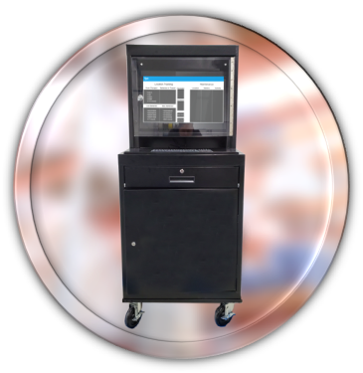
THE BATTERY MANAGER SYSTEM
THE WORKSTATION
BATTERY MANAGER WORKSTATION
Includes:
Barcode printer for battery, charger, and lift truck assets
Digital training scrolling placard
Barcode holder storage
Uninterruptable power supply
Dual redundant controllers

Slide 9
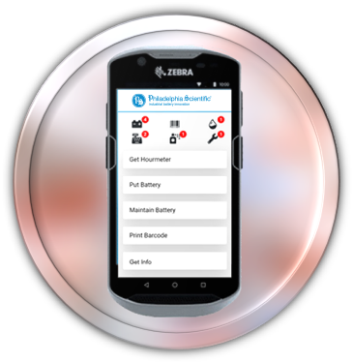
THE BATTERY MANAGER SYSTEM
THE TOUCH COMPUTER
TOUCH COMPUTER
Includes:
Highly reliable with Wi-Fi connection
Print barcodes from Touch Computer
Help text and videos for each activity
Scan from several feet away
As simple to use as an iPhone
Three year “no questions asked” replacement program

Slide 10
WITH BATTERY MANAGER’S PREMIUM REPORTING SERVICE, MAXIMIZING THE PERFORMANCE OF YOUR DC POWER FLEET IS EASIER THAN EVER

Slide 11
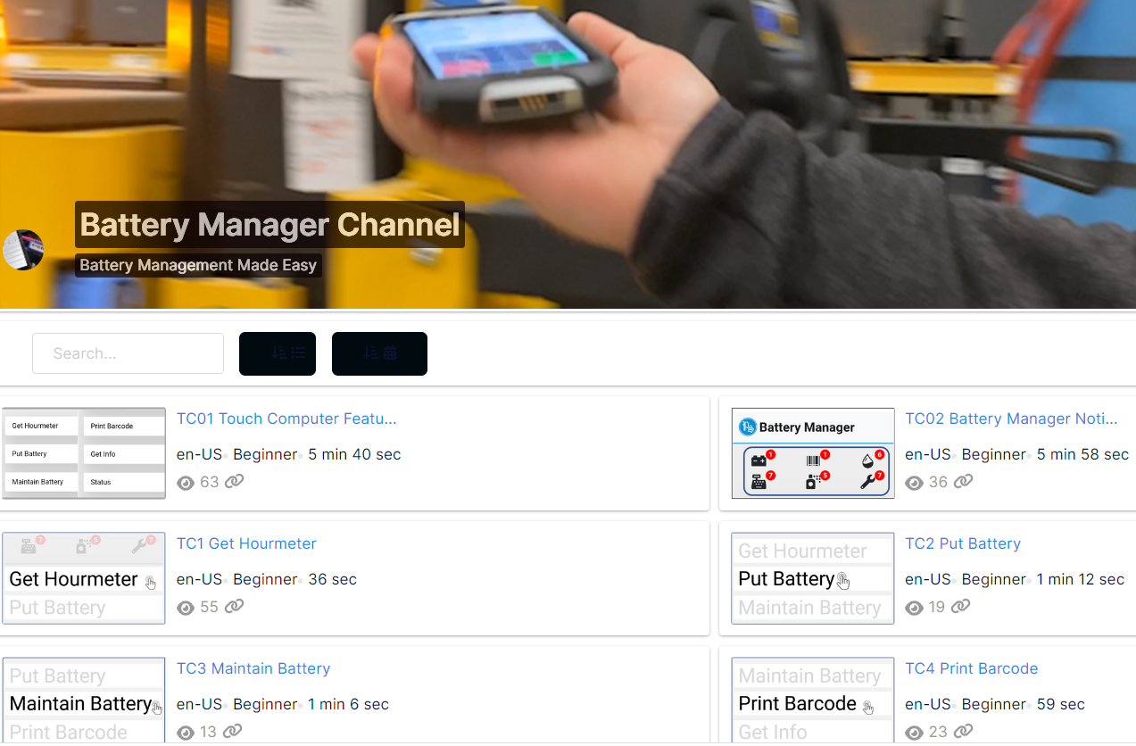
LEARNING MANAGEMENT PLATFORM
EVERY BATTERY ROOM EMPLOYEE TRAINED ACROSS THE ENTERPRISE
24/7 EMPLOYEE TRAINING
Cloud based learning management platform accessible via any web browser or Touch Computer
Digital scrolling placard in battery room with battery room educational videos for on site employee SOPs
Onboard and train new employees quickly and efficiently across the enterprise

Slide 12
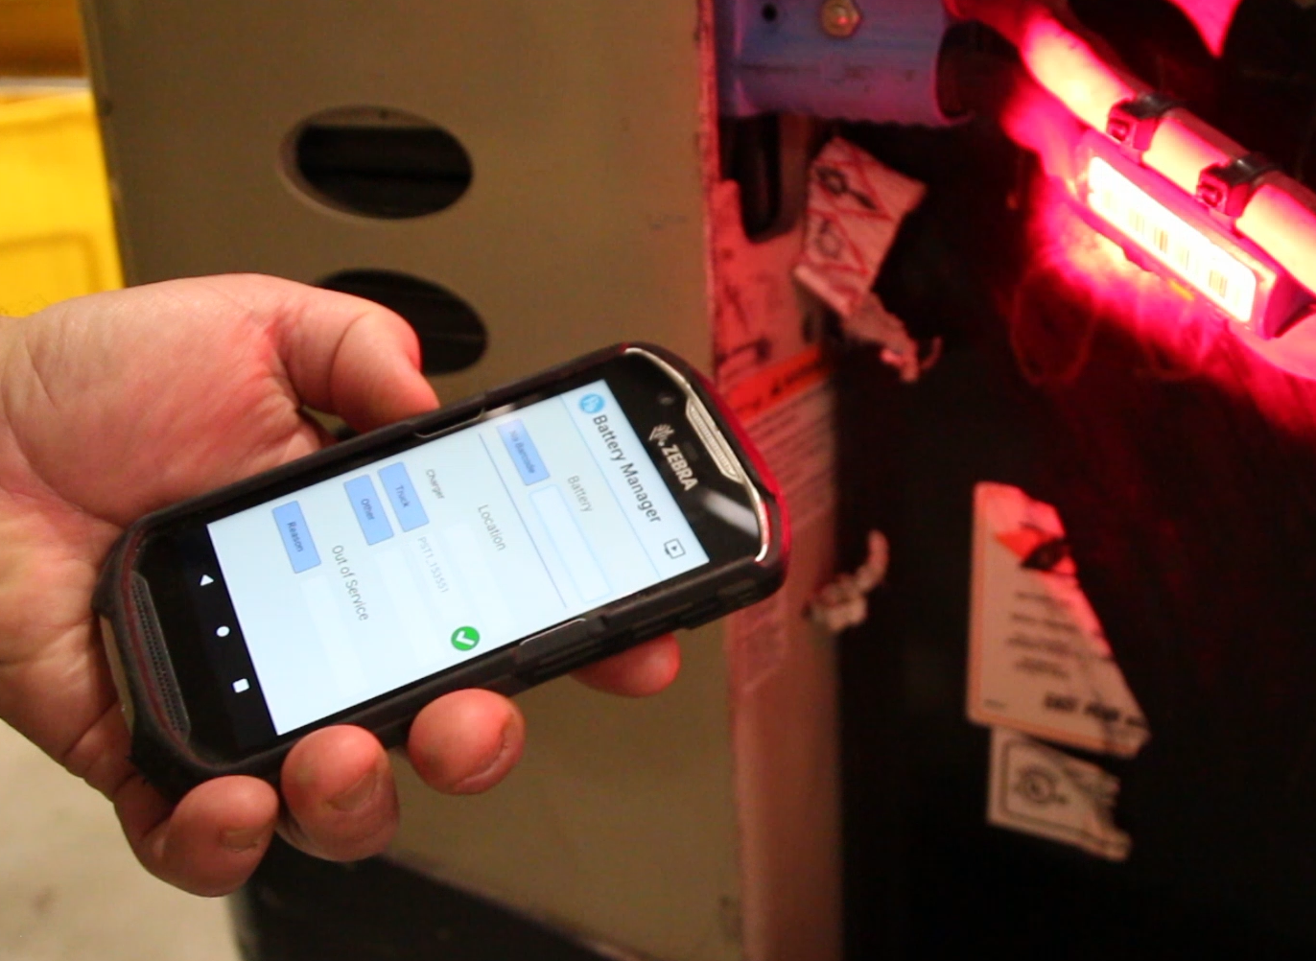
BATTERY MANAGER PREMIUM REPORTING
HOW BATTERY MANAGER DATA CONNECTS YOU TO YOUR ASSETS
ON SITE, REAL-TIME DATA
The Get Info option on the Touch Computer screens gives a whole range of metrics for each of the assets on site
These metrics are shown immediately after the barcode on the asset has been scanned
You can see when critical information such as when the battery was last watered and equalized all at the touch of a button

Slide 13

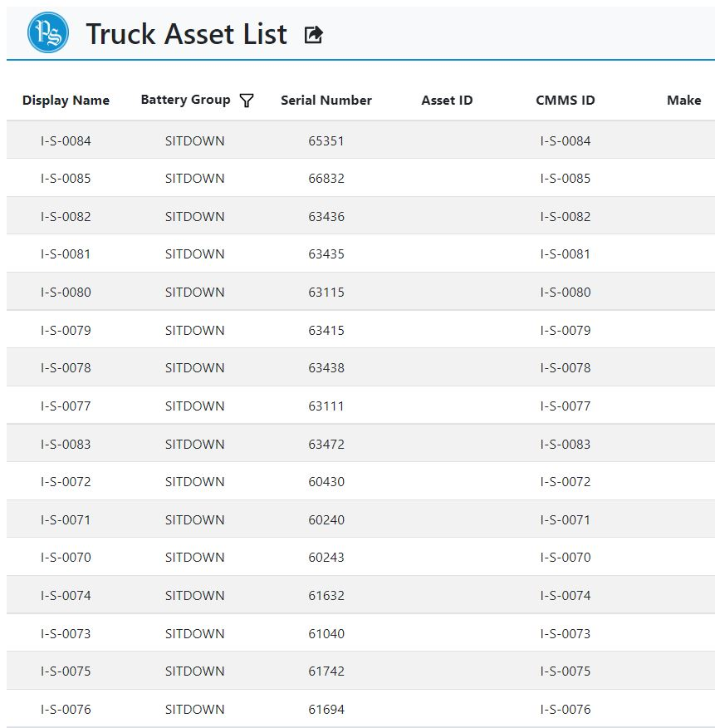
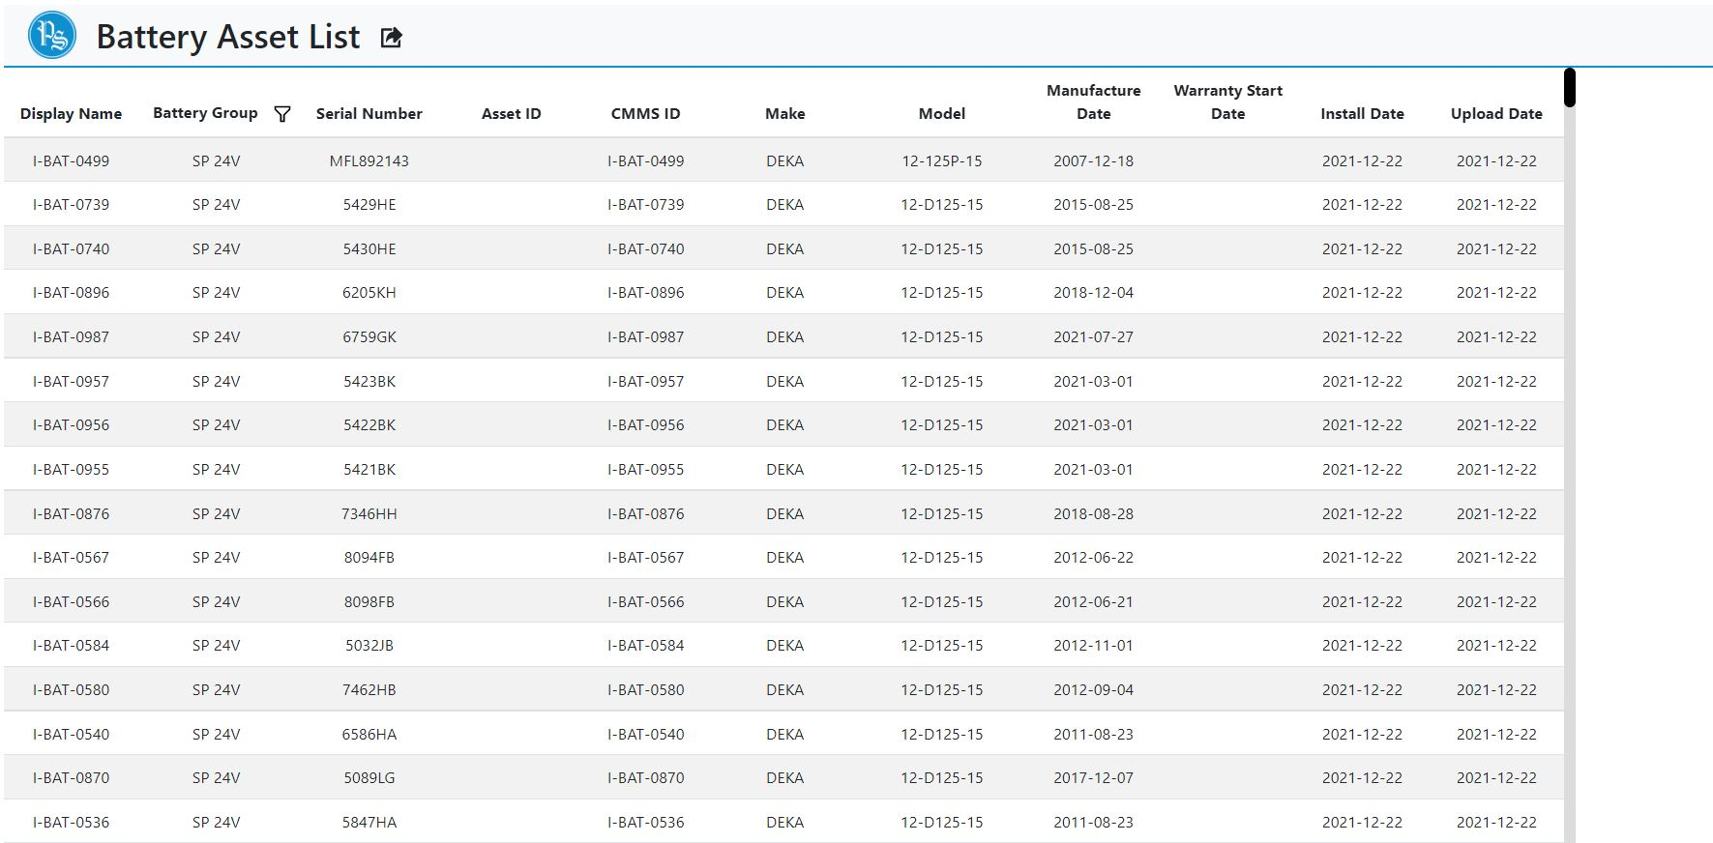
BATTERY MANAGER PREMIUM REPORTING
A SIMPLE WAY OF PROTECTING MILLIONS OF DOLLARS OF ASSETS
ASSET LIST
The Battery Asset List gives you a thoroughly comprehensive list of each of your battery assets, the same is true of the Truck Asset List for each of your trucks.
Combined, this gives you a complete overview of what assets you have on site at any one time.

Slide 14
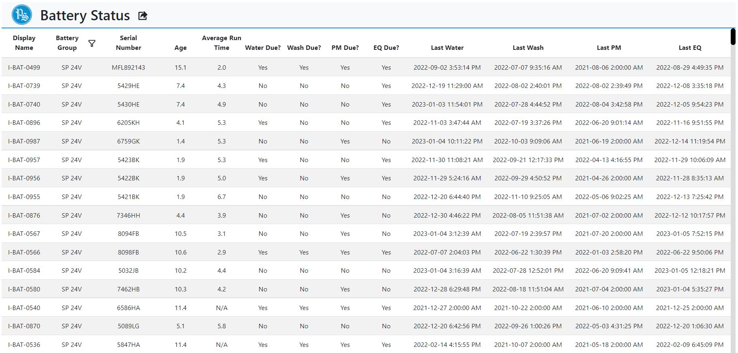
BATTERY MANAGER PREMIUM REPORTING
KNOWLEDGE OF YOUR POWER ASSETS IS CRUCIAL
BATTERY STATUS
The Battery Status screens gives you a snapshot view of every battery on site
From the age of the battery, to the date and time of the last equalize charge, this list allows you to view the top level battery information quickly, easily and remotely, so you don’t have to chase down batteries
This information is also recorded in the battery history tab, for each and every battery

Slide 15
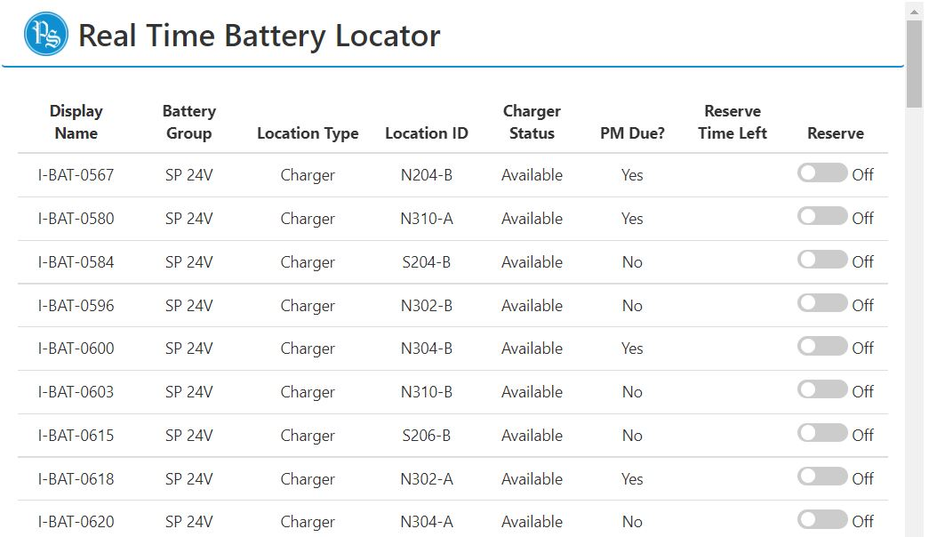
BATTERY MANAGER PREMIUM REPORTING
KEEPING TRACK OF ALL OF YOUR ASSETS IS NOW SIMPLE
REAL TIME LOCATOR
The Real Time Battery Locator tab allows you to see the exact location of a battery
You’ll be able to not only see if it’s on charge, you can see the exact charger it’s on. It can also give you the exact truck that the battery is on if it’s already on a truck
No more having to chase down the location of a battery to carry out a service

Slide 16
BATTERY MANAGER PREMIUM REPORTING
HOW BATTERY MANAGER DATA CONNECTS YOU TO YOUR ASSETS
10 UNIQUE REPORTS
VIEW BY SINGLE SITE OR ENTERPRISE
Site Detail
Battery Asset List
Battery Status
Battery History
Battery Run Time
Battery Detail
Real Time Battery Locator
Truck Asset List
Truck Run Time
Asset Manager

Slide 17
BATTERY MANAGER PREMIUM REPORTING
THE BENEFITS OF HOW BATTERY MANAGER DATA CONNECTS YOU TO YOUR CLIENT
Site Detail - https://youtu.be/DUZFcxQaTXM
Battery Asset List - https://youtu.be/rmTw_x14WyQ
Battery Status - https://youtu.be/R-xEhvisNSw
Battery History - https://youtu.be/8teD_pwqrRw
Battery Run Time - https://youtu.be/QFLVc8vRd5s
Battery Detail - https://youtu.be/iz2kPymOUCk
Real Time Battery Locator - https://youtu.be/qJNmh1LUvZE
Truck Asset List - https://youtu.be/Ic5K5Un45xY
Truck Run Time - https://youtu.be/tmVSE1pdHYU
Asset Manager - https://youtu.be/TW3Nphtg63U

Slide 18
THANK YOU

